Slide 1
Explainable Graph Neural Networks & Hybrid Graph Databases for Brain Biomarker Discovery
Mathematical Formulation of Non-Euclidean Connectomes in Neurodegenerative Pathology
Animesh Basak (26911001)
Department of Computer Science & Engineering
Indian Institute of Technology Roorkee (IIT Roorkee)

Slide 2
1. Problem Statement: Clinical Motivation & Graph Paradigm
A. Clinical Urgency: Functional Disconnection Precedes Structural Atrophy
• Clinical Urgency: >55M people worldwide suffer from neurodegenerative diseases (Alzheimer's, Parkinson's).
• Diagnostic Bottleneck: Clinical symptoms appear only after irreversible structural neuron loss (>50%).
• Pre-Symptomatic Precursor: Pathological disconnection begins years earlier in resting-state functional brain networks.
• Research Goal: Formulate a computational framework to detect topological breakdown in fMRI connectomes before anatomical atrophy occurs.
B. The Non-Euclidean Dilemma: Why Standard Deep Learning Fails
1. Voxel-wise Mass Univariate: Tests ~100k voxels independently: y_v = beta * X_v + eps. Incurs massive multiple hypothesis testing penalties (Bonferroni / FDR) and completely ignores inter-regional relational topology.
2. Euclidean Deep Learning Failure: Standard CNNs assume regular translational Euclidean grids. Brain networks are non-Euclidean graphs with no canonical node ordering: Pi * A * Pi^T = A for all permutation matrices Pi in S_N.
3. Connectome Flattening: Reshaping correlation matrices into 1D vectors (N(N-1)/2 = 6,670 features) destroys spatial neighborhood geometry and leads to severe parameter explosion and overfitting on clinical cohorts.

Slide 3

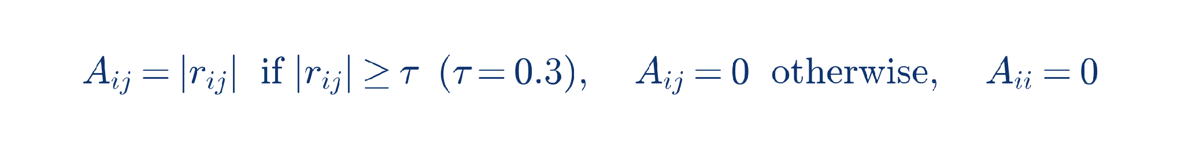
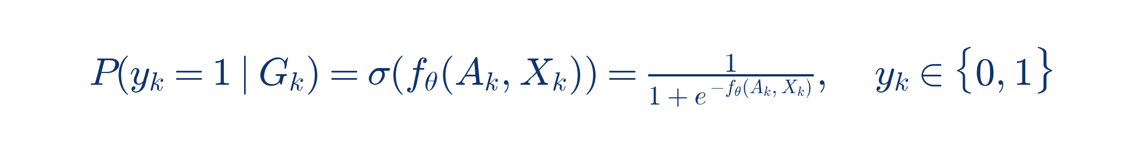

1. Problem Statement: Mathematical Connectome Formulation
A. Mathematical Formulation 1: Brain Connectome Graph G = (V, E, X)
• Anatomical Parcellation: Automated Anatomical Labeling (AAL-116) partitions brain into |V| = 116 anatomical ROIs.
• BOLD Time Series: For region i in V, let x_{i}^{t} in R^{T} represent blood-oxygen-level-dependent signal over T timepoints.
• Node Feature Matrix: X in R^{|V| x 5} with graph-theoretic descriptors (Degree, PageRank, Clustering, Betweenness, Eigenvector).
B. Mathematical Formulation 2: Graph Classification & Explanation Objectives
• Graph-Level Binary Classification Objective: Classify the whole-brain network state rather than isolated voxels:
• Subgraph Explanation Objective: Find explanatory subgraph M_k subseteq G_k maximizing Mutual Information:
Patient-Stratified Cross-Validation: S_train intersect S_test = emptyset (guarantees zero subject identity leakage).

Slide 4

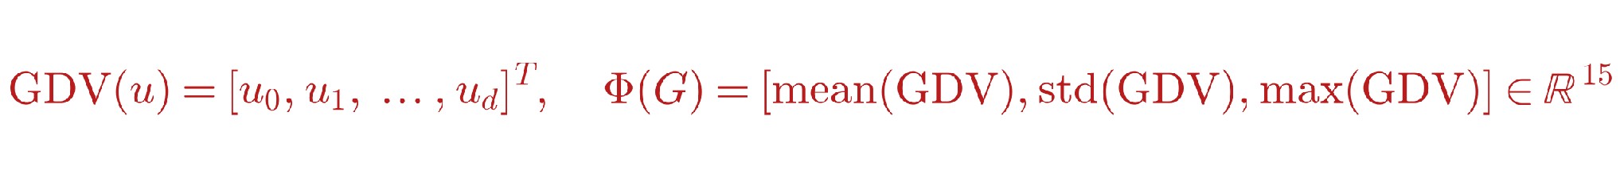
2. Baseline Models: Paper 1 & Paper 2
Paper 1: Kernel Support Vector Machines on Vectorized Connectomes
• Reference: Abraham et al. (NeuroImage 2017) / Cuingnet et al. (NeuroImage 2011)
• Vectorizes upper triangle of functional connectivity matrix into a flat 1D vector v in R^{6670}:
• Critical Limitation: Treats all 6,670 pairwise edges as independent Euclidean dimensions. Completely loses network topology, clique hierarchy, and hub clustering.
Paper 2: Random Forest with Graphlet Degree Vectors (RF-GDV)
• Reference: Pržulj et al. (Bioinformatics 2007) / Yaveroğlu et al. (Nature Scientific Reports 2014)
• Counts non-isomorphic small induced subgraphs (graphlets on 2-5 nodes, orbits 0-72):
• Critical Limitation: Relies entirely on static, handcrafted graph topological counts. Lacks end-to-end gradient backpropagation and cannot learn dynamic edge importance.

Slide 5
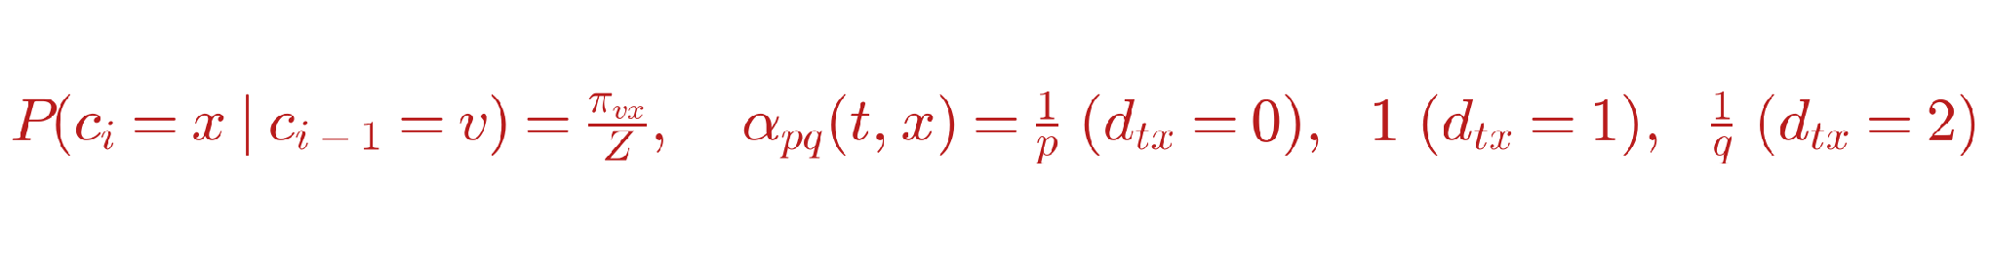

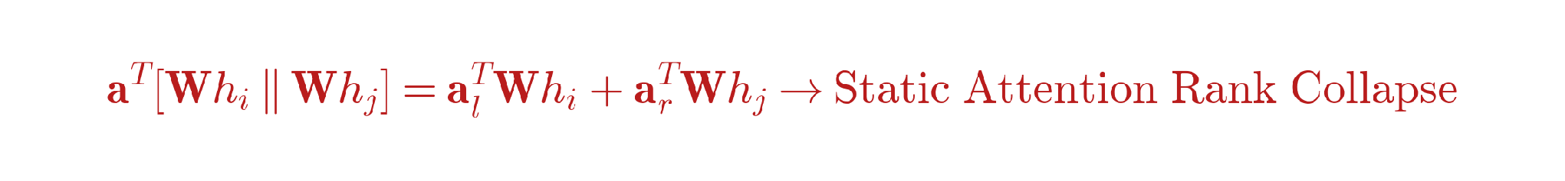
2. Baseline Models: Paper 3 & Paper 4
Paper 3: node2vec Biased Random Walk Connectome Embeddings
• Reference: Grover & Leskovec (KDD 2016) / Connectome Applications (Mahmood et al., 2021)
• Learns continuous node embeddings via 2nd-order biased random walks:
• Critical Limitation: Transductive random walk embeddings are trained unsupervised without disease label guidance; subsequent mean-pooling loses graph structural discriminability.
Paper 4: Standard Graph Attention Networks (GATv1)
• Reference: Veličković et al. (ICLR 2018) / BrainGNN (Li et al., Medical Image Analysis 2021)
• Self-attention over graph neighbors to weight regional communicative connections:
• Fatal Mathematical Flaw (Static Attention / Rank Collapse, Brody et al. 2021):
• Consequence: The neighbor ranking is global and identical for all query nodes i, preventing patient-specific adaptive attention.

Slide 6
2. Baseline Models: Comparative Summary of Limitations
Baseline Model | Mathematical Core | Graph Awareness | Explainability | Fatal Clinical Defect
RBF-SVM (Abraham '17) | max alpha - 0.5 sum alpha_i alpha_j y_i y_j K | Zero (1D flat vector) | None (Black-Box) | Destroys graph topology
RF-GDV (Pržulj '07) | sum T_b( OrbitCounts(G) ) | Scalar Motifs only | Gini feature rank | Static, unlearnable features
node2vec (Grover '16) | Skip-Gram over biased walks | Local random walk | None (Black-Box) | Unsupervised; misses disease signal
GATv1 (Li / Veličković) | Softmax( a^T [Wh_i || Wh_j] ) | Static Attention | Attention weights | Attention rank collapse (Brody '21)
Summary of Research Gaps in Baseline Literature
1. No Structural Hierarchy: Baselines treat brain as flat vectors or static subgraph counts, ignoring dynamic communication.
2. Static Attention Collapse: GATv1 fails to adapt attention ranking per patient due to linear projection coupling.
3. Multi-Site Brittleness: None of the existing baseline formulations calibrate for scanner SNR domain shift across hospitals.
4. Research Void to Address: Develop an end-to-end framework combining dynamic attention (GATv2), continuous edge attributes (Pearson r), non-linear noise gating (SwiGLU), and mathematically verifiable subgraph explainability.

Slide 7




3. Proposed Research: Edge-Aware Dynamic Graph Convolution
Pillar 1: Edge-Weight Aware GCN Structural Aggregation
• Mathematical Formulation 3 — Edge-Weight Aware Graph Convolution (Neighborhood Aggregation):
• Formulation: Injects continuous functional edge weights e_{ij} = |r_{ij}| rather than binary adjacency, preserving continuous functional coupling intensities with residual connections.
Pillar 2: GATv2 Dynamic Multi-Head Attention with Continuous Edge Attributes
• Mathematical Formulation 5 — GATv2 Dynamic Multi-Head Attention with Continuous Edge Attributes:
• Multi-Head Aggregation with Residual Stream:
• Mathematical Formulation: Placing non-linearity BEFORE projection eliminates static attention collapse, enabling strictly dynamic, query-dependent attention over disease-salient functional connections.
Pillar 3: Dual Global Graph Pooling [Mean || Max]
• Mathematical Formulation 6 — Dual Global Graph-Level Readout Concatenation:
• Mathematical Formulation: Preserves both whole-brain background connectivity (Mean) and focal lesion hubs (Max).

Slide 8

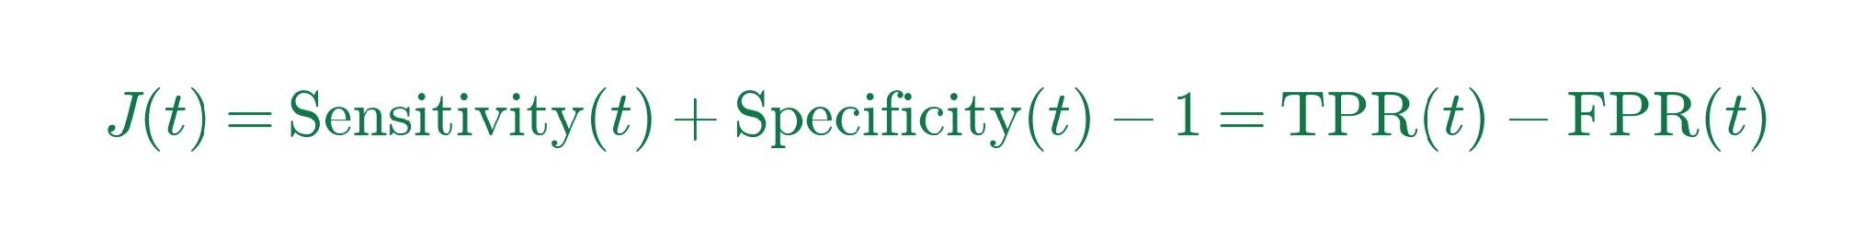

3. Proposed Research: SwiGLU Noise Gating & Calibration
A. SwiGLU Multiplicative Noise Gating in Classifier Head
• Mathematical Formulation 7 — Swish Gated Linear Unit (Shazeer, 2020; LLaMA 3 Architecture):
• Classification Logits: z = W_cls * Dropout( SwiGLU(h_G) ) in R^2, P(y=1|G) = ( e^{z_1} ) / ( e^{z_0} + e^{z_1} )
• Mathematical Formulation: Multiplicative gating branch (x) acts as a dynamic noise filter, suppressing multi-site scanner noise fluctuations while amplifying subtle functional disconnection signals.
B. Decision Threshold Calibration via Youden's J-Statistic
• Multi-Site Domain Shift Challenge: Scanner SNR variations shift predicted test probabilities, making the default arbitrary p = 0.5 decision boundary sub-optimal.
• Mathematical Formulation 8 — Youden's J-Statistic Optimization (Youden, 1950):
• Optimal Calibration Rule on Validation ROC Curve:
• Formulated Effect: Realigns operational test accuracy directly with the model's true discriminative ROC-AUC, eliminating multi-site threshold bias.

Slide 9


3. Proposed Research: GNNExplainer Mathematical Framework
A. Information-Theoretic Biomarker Extraction Objective
• Goal: Identify compact explanatory subgraph G_s = (V_s, E_s) that explains disease prediction y_hat.
• Information-Theoretic Mutual Information Objective (Ying et al., NeurIPS 2019): max_{G_s} MI( Y, G_s ) = H(Y) - H( Y | G = G_s )
• Mathematical Formulation 9 — Continuous Relaxation with Entropy Regularization:
• Entropy Term Enforces Crisp Binary-like Edge Masks:
• Gradient Optimization: Model weights theta are frozen; gradients backpropagate strictly to masks: M <- M - eta * nabla_M L_explainer.
B. Biological Hypotheses for Discovered Neural Biomarkers
• Planned Consensus Neural Biomarker Targets:
1. Cerebellar Vermis Hubs: Vermis_6 to Vermis_10 (Detecting Cerebellar Cognitive Affective Syndrome).
2. Cortico-Striatal Disruption: Lingual_L <-> Putamen_L (Visual-motor integration breakdown).
3. Default Mode Network (DMN) Decoupling: Cerebelum_9_R <-> Cingulum_Post_L (Posterior Cingulate hub disruption, clinical hallmark of Alzheimer's).
4. Memory-Attention Circuit: Hippocampus_L <-> SupraMarginal_R (Episodic memory to parietal attention disconnection).

Slide 10
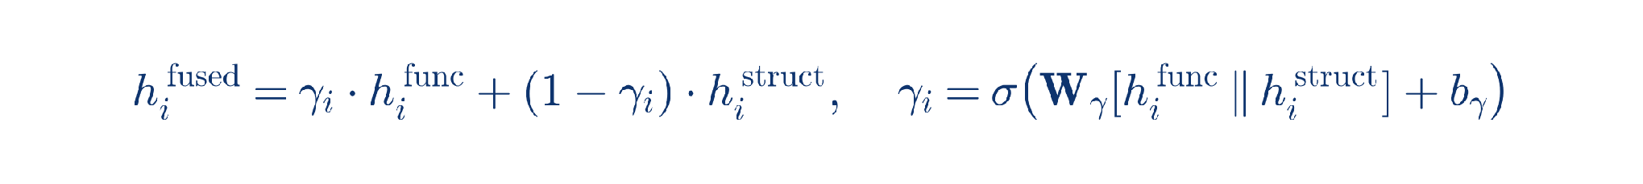
3. Proposed Research: Multi-Modal Graph Fusion (fMRI + DTI)
A. Mathematical Framework for Multi-Modal Functional-Structural Graph Fusion
• Motivation: Functional disconnection (fMRI) is physically constrained by white-matter axonal structural pathways (DTI). Combining functional and structural connectomes resolves false-positive correlations.
• Mathematical Dual-Graph Formulation: Each subject k is modeled as a dual-relational graph G_k = (V, E_{func}, E_{struct}, X):
Functional Graph: A_{func} in R^{|V| x |V|}, A_{func}(i, j) = |r_{ij}| (Pearson correlation from resting-state fMRI)
Structural Graph: A_{struct} in R^{|V| x |V|}, A_{struct}(i, j) = FA_{ij} * log(N_{ij} + 1) (Fractional Anisotropy & Streamline count from DTI)
• Proposed Multi-Modal Gating Operator (Functional-Structural Fusion):
• Unified Graph Readout: h_G = [ MeanPool(h^{fused}) || MaxPool(h^{fused}) ] -> SwiGLU -> Binary Classification P(y=1 | G).
B. Validation Strategy & Benchmark Roadmap
• Target Datasets for Validation: ADNI (Alzheimer's Disease Neuroimaging Initiative) & PPMI (Parkinson's Progression Markers Initiative).
• Rigorous Validation Protocol: 5-fold Subject-Stratified Cross-Validation across distinct clinical scanner centers.
• Evaluation Criteria: Macro-F1 (primary clinical metric), ROC-AUC, Calibrated Accuracy (Youden's J), and Biomarker Subgraph Jaccard Stability.

Slide 11
Summary of Proposed Contributions & Technical Timeline
Proposed Core Contributions
1. Relational Connectome Modeling: Formulate brain graphs natively in a persistent graph database (Neo4j) with topological centrality feature descriptors.
2. Dynamic Neural Architecture: Eliminate GATv1 static rank collapse via GATv2 dynamic attention with continuous Pearson edge attributes.
3. Scanner Invariant Representation: Introduce SwiGLU noise gating and Youden's J calibration to defeat hospital scanner domain shift.
4. Verifiable Clinical Biomarkers: Information-theoretic subgraph extraction via GNNExplainer identifying consensus neural disease circuits.
Research Execution Timeline
• Phase 1 (Architecture Formulation): Implement Edge-weight aware GCN + GATv2 + SwiGLU gating in PyTorch Geometric.
• Phase 2 (Explainability Pipeline): Develop GNNExplainer module for automated consensus circuit extraction.
• Phase 3 (Multi-Site Calibration): Integrate Youden's J-statistic optimization for multi-center clinical deployments.
• Phase 4 (Multi-Modal Extension): Fuse functional fMRI connectomes with structural DTI tractography on ADNI/PPMI datasets.
• Phase 5 (Clinical Deployment): Package pipeline into a lightweight FastAPI inference service with drift monitoring.

Slide 12
Thank You

